Slide 1

House Property Sales Time Series
MAS766_M002 Presentation I
2020/10/29
Group5 Members:
Chen, JIeer
Qian, Liuqi
Zhang, Ruiwei
Zhu, Renjie

Slide 2
OUTLINE
1. Data Source
2. Data Description
3. Research Question

Slide 3
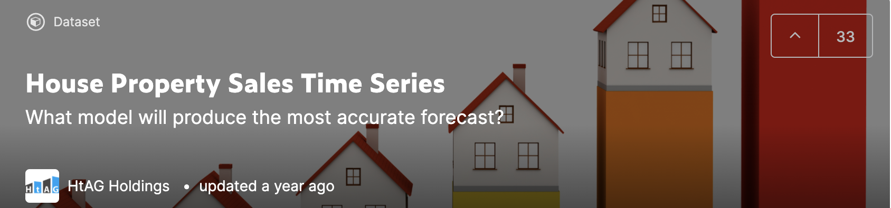
DATA SOURCE
Kaggle.com
https://www.kaggle.com/htagholdings/property-sales?select=raw_sales.csv

Slide 4
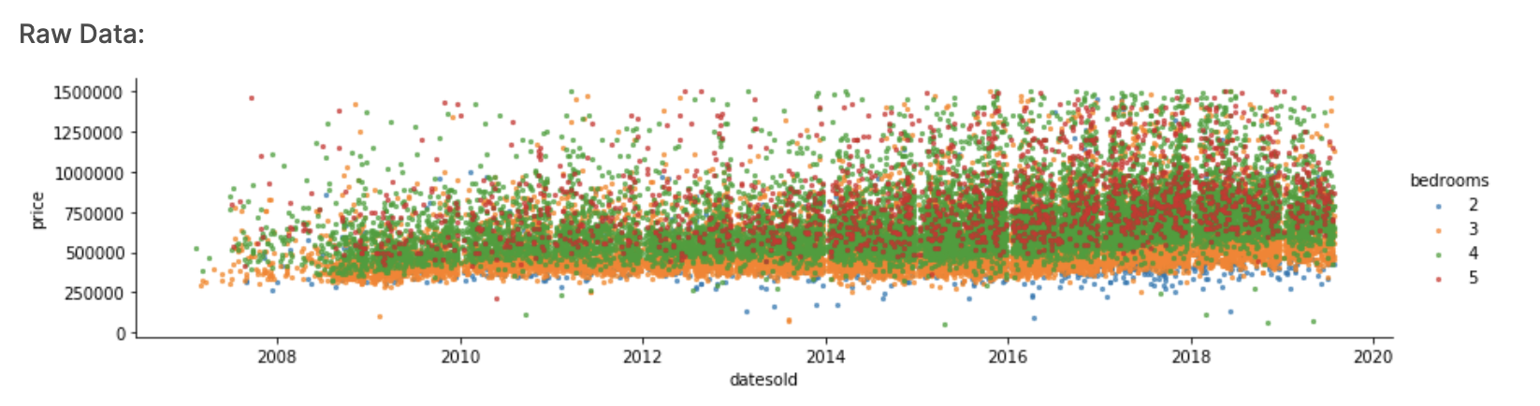
DATA DESCRIPTION
We have accumulated property sales data for the 2007-2019 period for one specific region. The data contains sales prices for houses and units with 1,2,3,4,5 bedrooms. These are the cross-depended variables. The chart illustrates these variables for houses.
The chart illustrates these variables for houses:

Slide 5
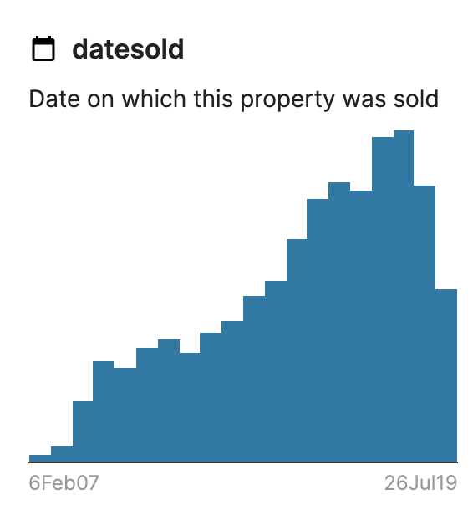
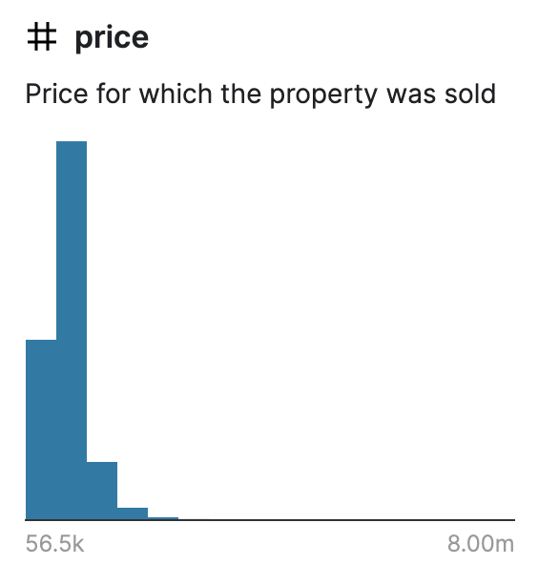
DATA DESCRIPTION
The data has ___ rows and 5 columns. It can be summarized as:
Datesold: date of sale
price: price of sale
property type: unit or house
number of bedrooms: 1,2,3,4,5
4digit postcode of the suburb where the property was sold (this is for reference only, we don't expect that this data point will be useful)

Slide 6
RESEARCH PLAN
Key Questions:

